Slide 1
Defending Against Low-rate TCP Attacks: Dynamic Detection and Protection
A summary of the paper

Slide 2
Introduction
Low-rate is a periodic is a periodic short burst which exploits homogeneity of minimum retransmission timeout (RTO)
RTO is used to combat network congestion. However, it can also be used by an attack to effect a low-rate attack
In a low-rate attack, an attacker sends attack traffic at times of retransmission to overflow a router’s queue and causes packet loss
That is, attack period is synchronised to duration of RTO
However, the long-term rate of traffic is quite low and hence, this type of attack is difficult to detect than more traditional, brute-force, flooding style attacks

Slide 3
Signature of attack traffic
Basic signature of attack traffic is intermittent short bursts of high-rate traffic in between periods of little or no activity (eg. A periodic square wave)
Reasons for deviation from basic signature:
Queuing in intermediate routers
Aggregation with background traffic (eg. UDP traffic)
Attacker’s own attempt to inject noise to escape detection
Distributed attack: Attack from individual sources does not have required characteristics, but their aggregation does. However, it is difficult to effect, since it requires synchronization between individual sources
Strategy after detection: limit rate and preferentially drop packets to prevent loss of good user traffic

Slide 4
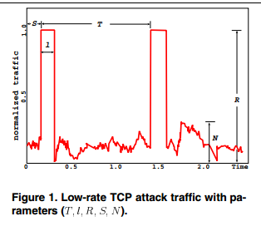
Formal description of low-rate attacks

Slide 5
Formal description of low-rate attacks
Periodic square wave
T: period of square wave (approximately one second)
l: period during which wave has non-zero magnitude
R: non-zero magnitude of wave normalized by router capacity C, hence value of R is between (0,1]
Average bandwidth of wave is Rl divided by T
For low-rate attack, ration of l to T is small
S is the time shift from initial measurement instance to beginning of the attack pulse
N denotes the amount of background noise (i.e. background traffic)

Slide 6
Formal description of low-rate attacks
Value of T:
Optimum value is 1. Lies in [1, 1.5]
Value of l:
Greater than the maximum round-trip from a TCP source to the victim router
However, it cannot be too close to T
Value of N:
N<=bR , b<=0.5

Slide 7
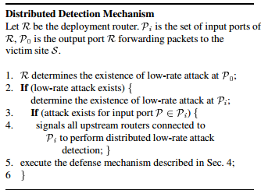
Distributed detection

Slide 8
Distributed detection
Advantages:
Pushes detection of attack as close as possible to attack sources
Limits damage to legitimate TCP source
Steps:
Statistical sampling of incoming traffic
Noise filtering
Feature Extraction
Signature matching

Slide 9
Statistical sampling of incoming traffic
TS =sampling period
TS>=2T
TS should not be too large as it implies higher computational cost for feature extraction at a later stage
Traffic normalization: done because different link interfaces have different line speeds
Throughput normalized with respect to maximum line speed
Normalized throughput =
(sample throughput )/ (maximum line speed)

Slide 10
Noise filtering
Sources of noise:
Packets that are forwarded to the same port but are not destined for the victim site
TCP packets – especially from flows with large RTTs – which can survive the low-rate TCP attack
UDP packets which will not back off in the face of low-rate attacks or network congestion in general
These have higher frequency or low magnitude compared to attack burst
Hence, low pass filter can be used to filter out high frequencies
Clamp all the sampled signals to zero if they are less than or equal of a fraction b of R. (b = 0.5 taken)

Slide 11

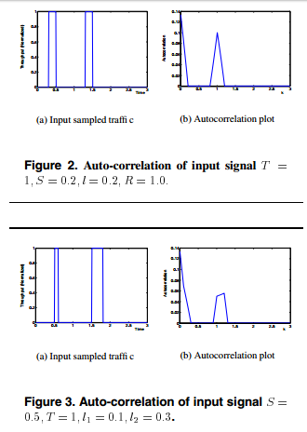
Auto-correlation

Slide 12
Pattern Matching via Dynamic Time Wrapping (DTW)
Similarity between extracted features and signature calculated with the help of a distance matrix calculated with the help of time-series representation
Minimum cost warping path is found by using dynamic programming
Types of input traffic:
Square burst
Step-like burst
General burst

